Slide 1


Did the political climate exacerbate the pandemic in the U.S.?
Exploring partisanship, public sentiment, adherence to safety protocols, and COVID-19 Cases
University of New Hampshire
Brittany Morin

Slide 2
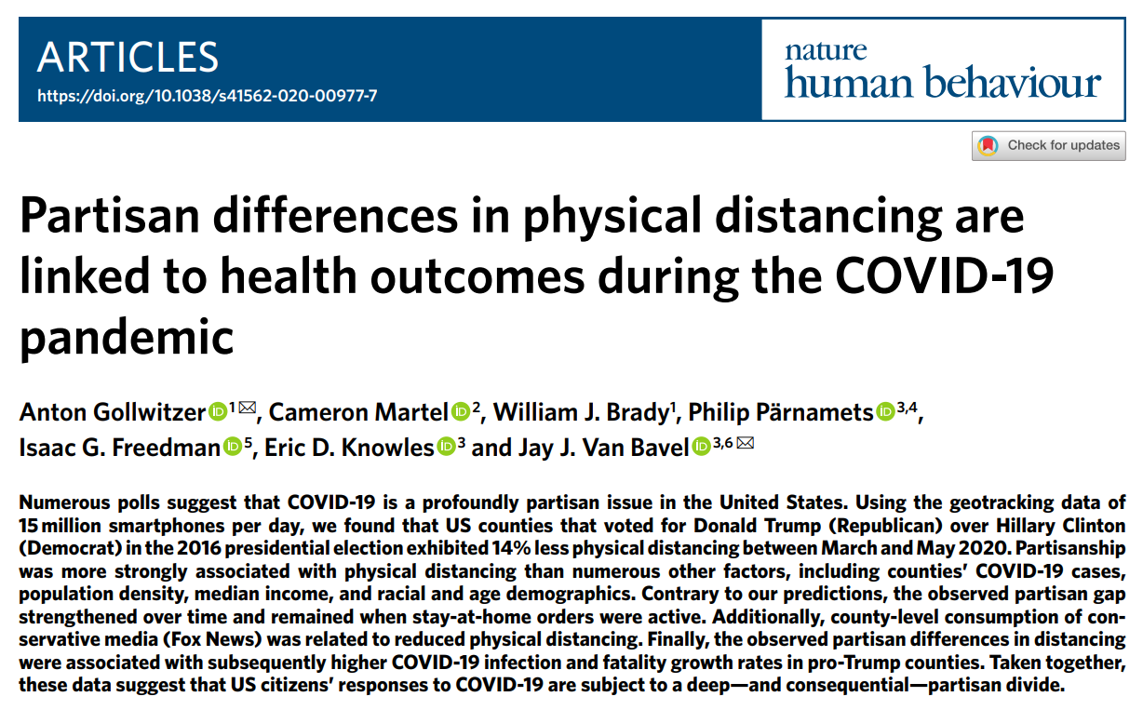

Slide 3

Introduction
Gollwitzer et. al. is a kind of framework.
Population: 3,025 U.S. counties
Data range: March 9 – May 29, 2020
3-level mixed model
Lots of covariates
Definition of partisanship variable

Slide 4

So, what are we seeking here? -Introduction cont.-
H₀ : Partisanship has no significant correlation to COVID outcomes with any of the mediating variables measured.
H_{a} : A significant relationship can be found between partisanship and COVID outcomes via:
_{Online sentiment}
_{Mask Adherence}
_{Distancing Adherence}

Slide 5

Even more introduction
Time – Most studies in this area have only included about 2-5 months of COVID data from around the start of the pandemic/lockdown periods. We expand the data to include a full year of COVID data in relation to cases and deaths at the county level.
Location – Many studies looked at the data on a state level, but we have drilled down to the county level.
Variables – Studies have been done on sentiment surrounding COVID-19, how physical distancing was measured by partisanship, and how mask adherence affects infection rates in subsequent weeks. This research analysis sought to combine all these factors into a single time series dataframe in order to draw relationships among all of them.

Slide 6
Datasets
COVID-19 Outcomes
Partisanship
Adherence to safety mandates
Online sentiment

Slide 7
Covariate/Interaction Variables
Median income
Income inequality
Median age
Age composition
Race/ethnicity proportion
Governor’s party affiliation
Employment percentage
Low access to grocery stores
Number of grocery stores
Travel time to work
Religiosity
Whether mandates were active
Change in life expectancy from 1985-2010

Slide 8
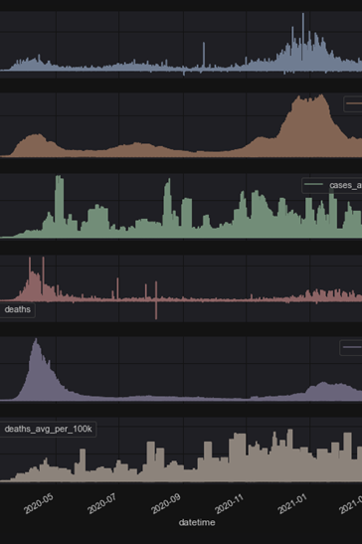
COVID-19 Data
Source: The New York Times. (2021). Coronavirus (Covid-19) Data in the United States. Retrieved January 2022, from https://github.com/nytimes/covid-19-data
Features:
Date
Geoid/FIPS code
County name and state
Cases, average cases, average cases/100k
Deaths, average deaths, average deaths/100k
Raw data contains negative values for corrections on previous entries.

Slide 9
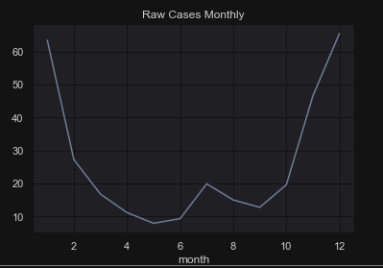
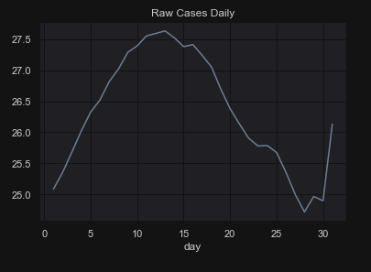
COVID-19 Data II
Data range: 3/01/2020 – 3/31/2021
(13 months)
3,138 counties in total in the data
Converted two ways:
1) into time series data by month
[all_covid and covid_ts]
2) by FIPS with state and county
[cases_by_fips]

Slide 10
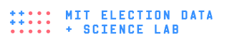
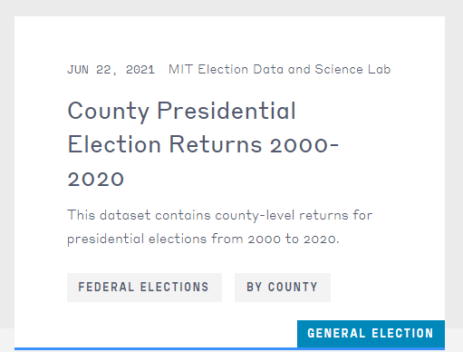
Partisanship
Source: https://dataverse.harvard.edu/dataset.xhtml?persistentId=doi:10.7910/DVN/42MVDX
2016 Presidential Election (Clinton vs. Trump)
Avoids COVID as a decision factor for voters

Slide 11
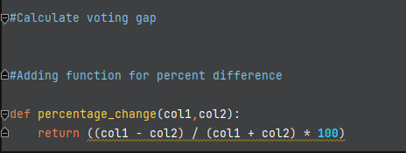
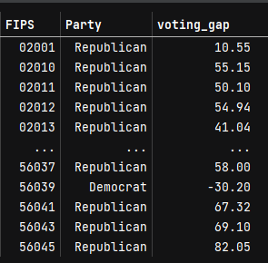
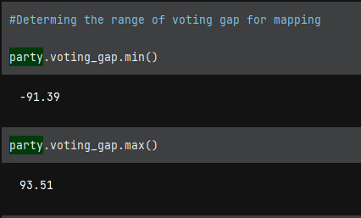
Voting Gap: Defining Partisanship Variable
Result:

Slide 12



Distancing
Social Distancing Metrics Dataset
“Median dwell time at home geohash-7 ("home") in minutes for all devices in the device_count during the time period. For each device, we summed the observed minutes at home across the day (whether or not these were contiguous) to get the total minutes for each device. Then we calculate the median of all these devices. Beginning in v2, we include the portion of any stop within the time range regardless of whether the stop start time was in the time period.”
Source: https://cmu-delphi.github.io/delphi-epidata/api/covidcast-signals/fb-survey.html

Slide 13
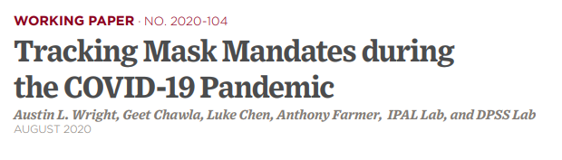
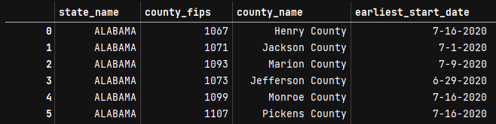
Masks
Source: https://bfi.uchicago.edu/wp-content/uploads/BFI_WP_2020104.pdf
Start date of mask mandate as variable
Spans six months total (March-August 2020)

Slide 14

Online Sentiment
Representative of the population?

Slide 15
Topic Modeling, I

Slide 16
Topic Modeling, II

Slide 17
Sentiment Analysis, I

Slide 18
Sentiment Analysis, II

Slide 19

From Datasets to Data
Univariate

Slide 20
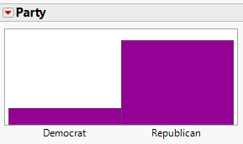
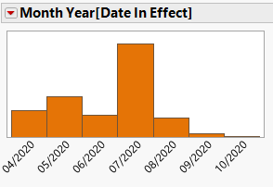
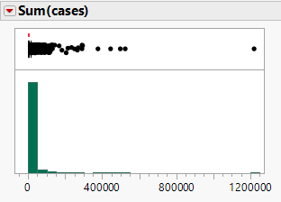
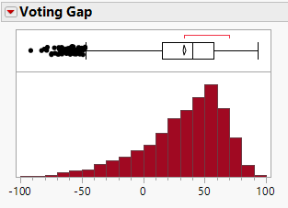
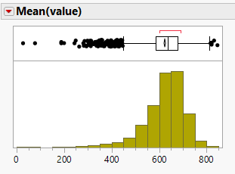
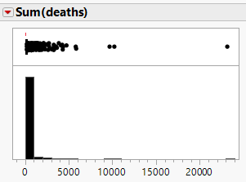
Distributions
Partisanship
Masks
Sentiment
COVID-19 By County
Distancing

Slide 21
Temporal Data

Slide 22
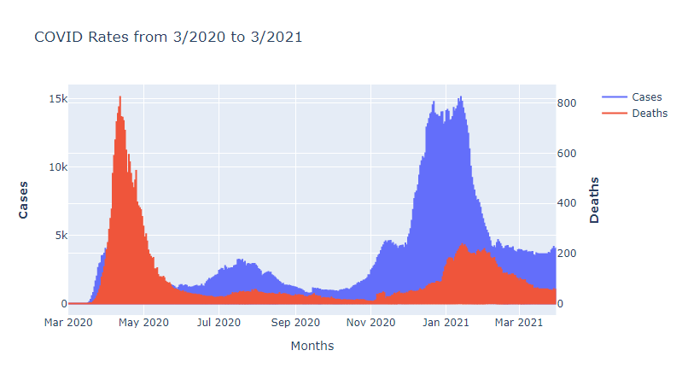
COVID-19 Over Time

Slide 23
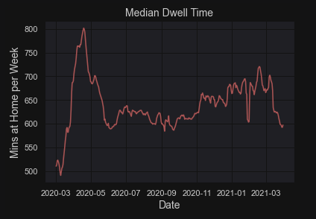
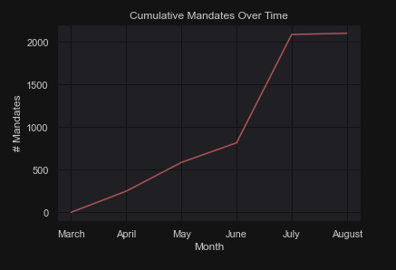
Trends Over Time: Independent Variables
Distancing
Mask Mandates
Online Sentiment
*Partisanship excluded here

Slide 24
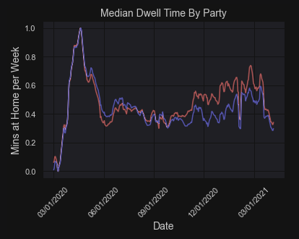
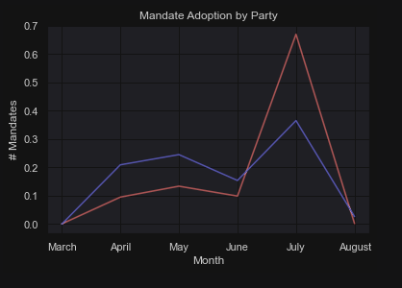
Trends By Partisanship
Distancing
Mask Mandates
Online Sentiment

Slide 25
Sentiment Over Time

Slide 26
Map Data

Slide 27
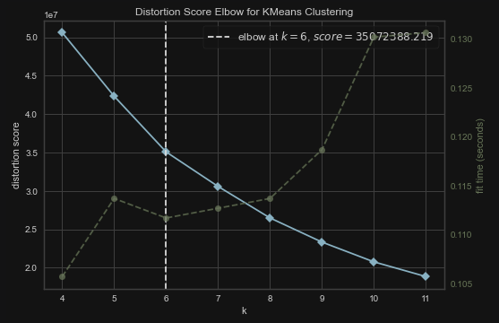
k-means Clustering COVID: Cases

Slide 28
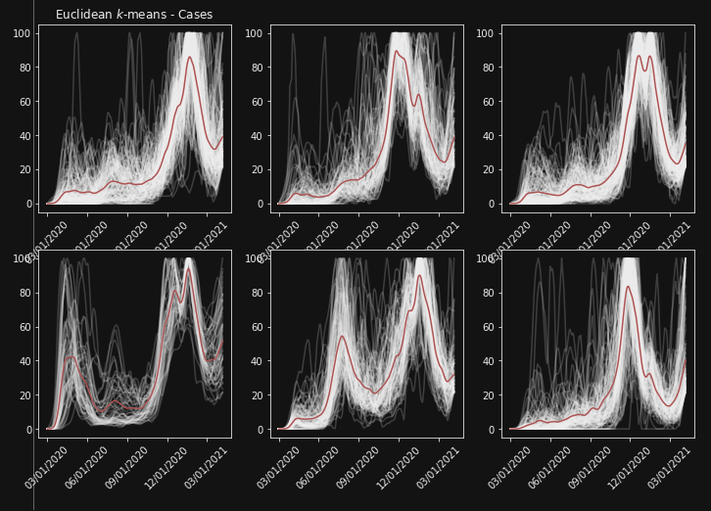
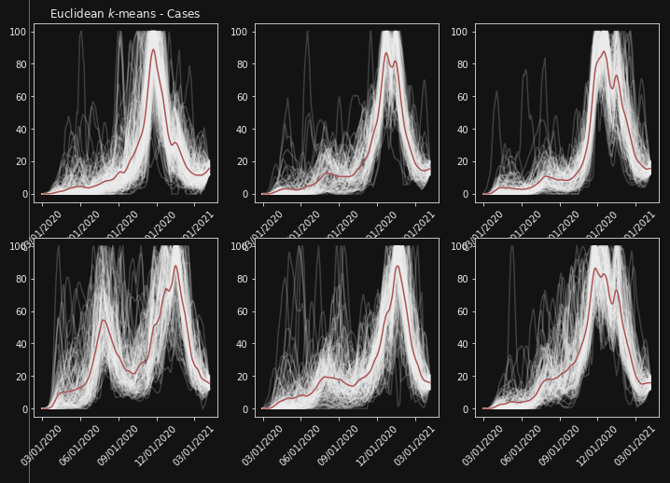
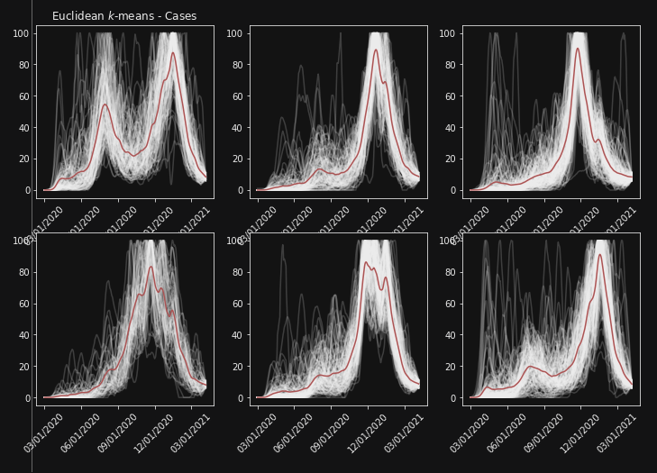
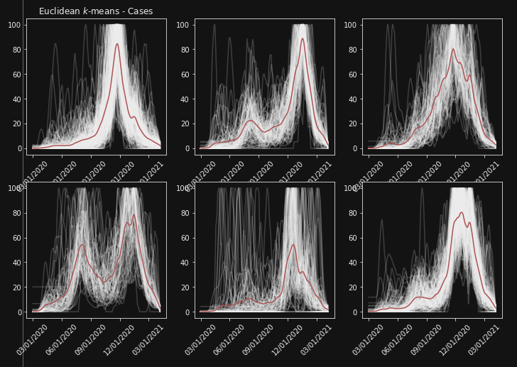
Quartile 1
Quartile 2
Quartile 3
Quartile 4

Slide 29
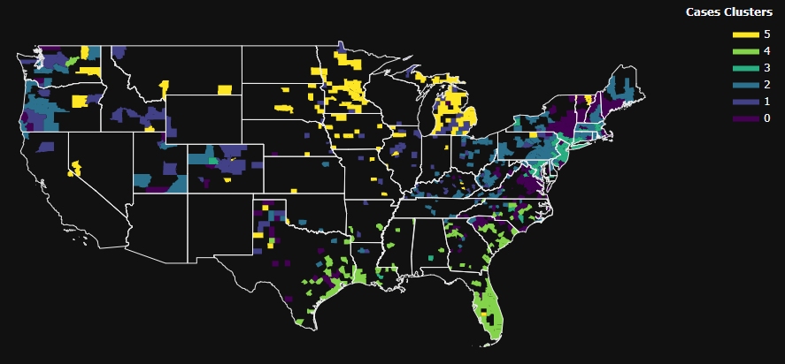
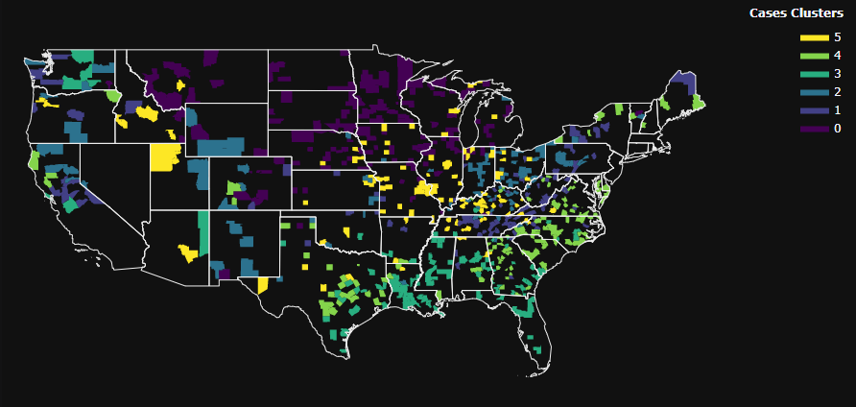
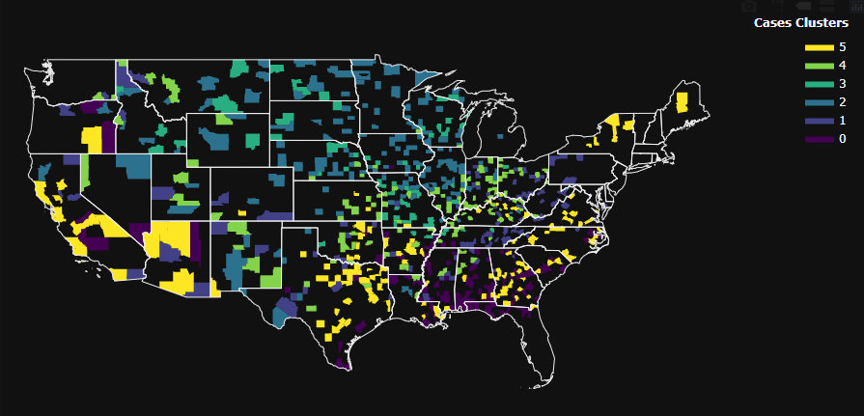
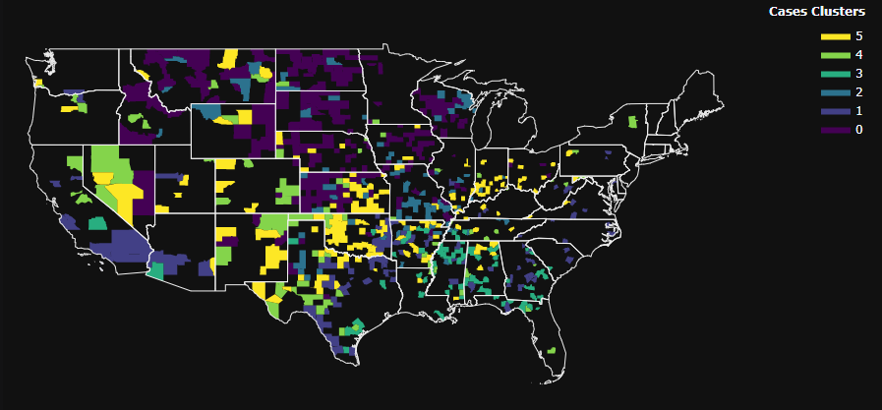
Quartile 1
Quartile 2
Quartile 3
Quartile 4

Slide 30
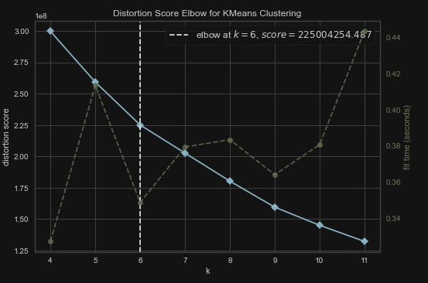
k-means Clustering COVID: Deaths

Slide 31
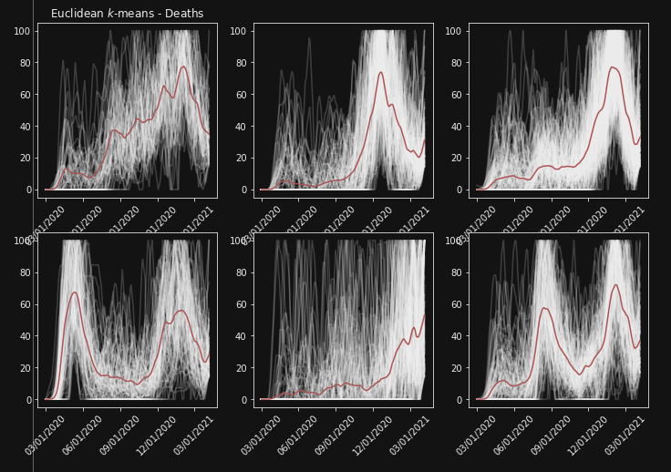
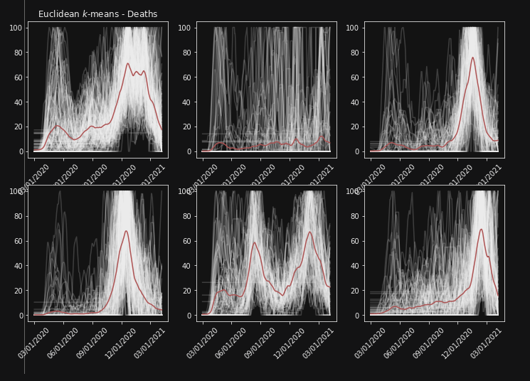
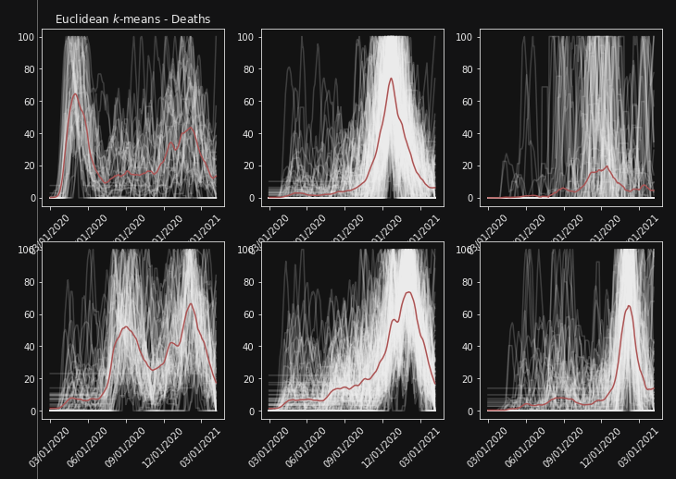
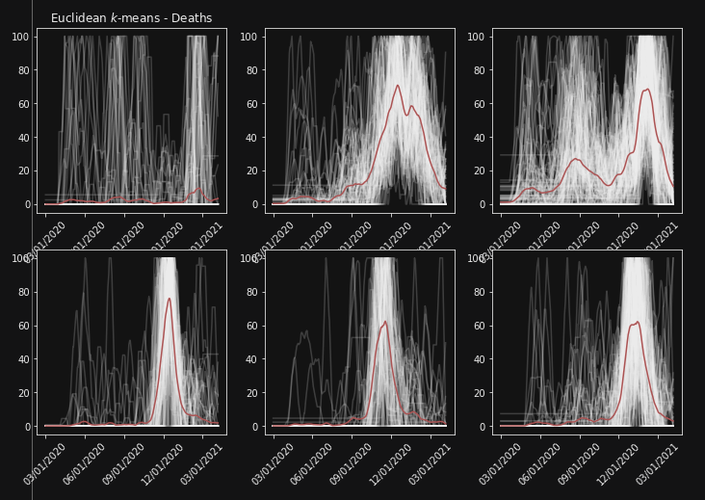
Quartile 1
Quartile 2
Quartile 3
Quartile 4

Slide 32
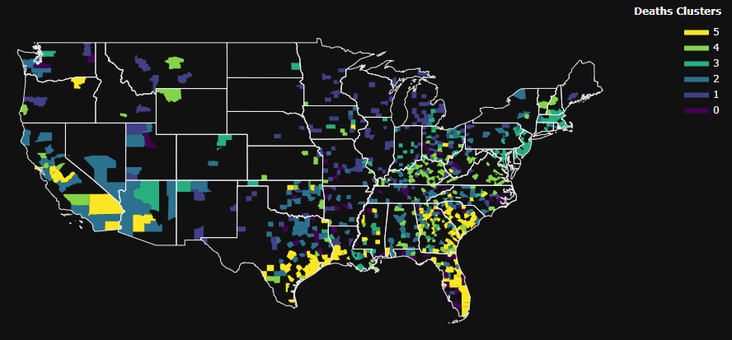
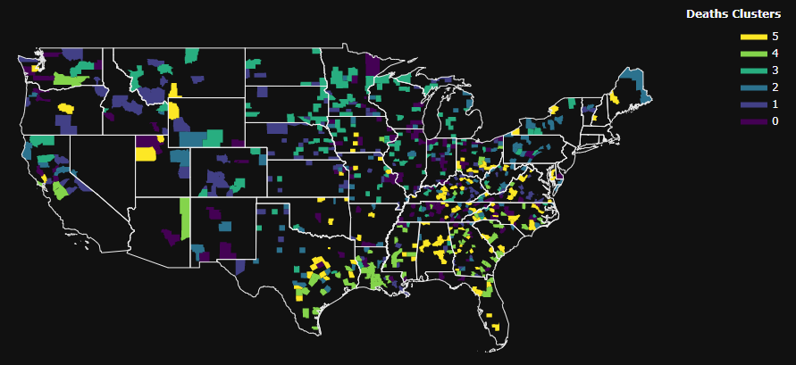
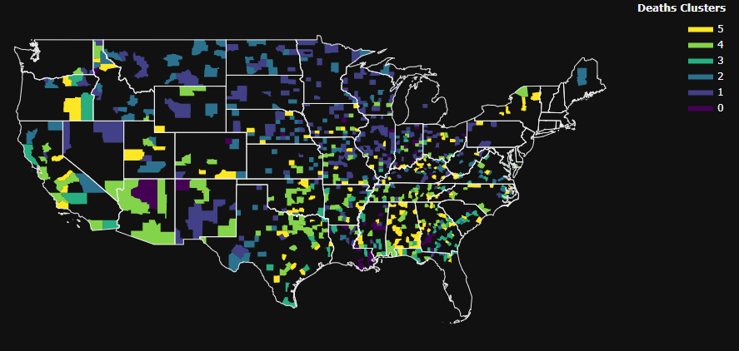
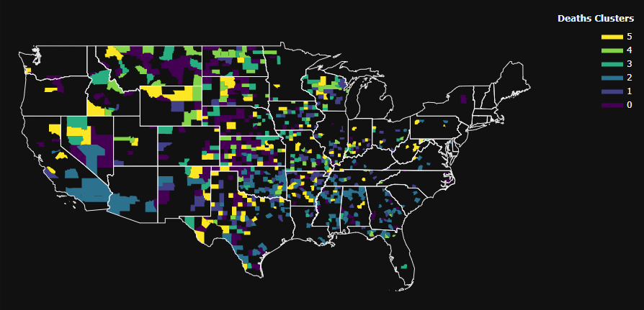
Quartile 1
Quartile 2
Quartile 3
Quartile 4

Slide 33
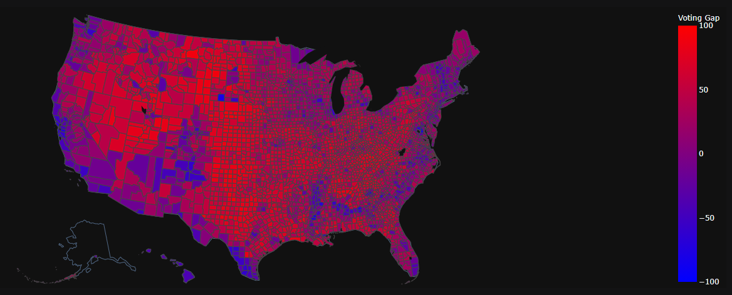
Partisanship

Slide 34
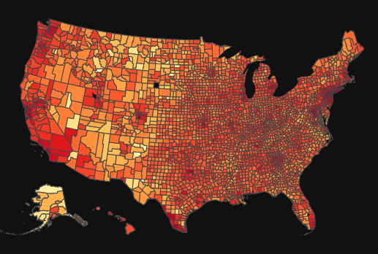
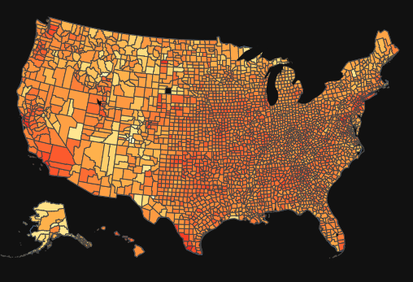
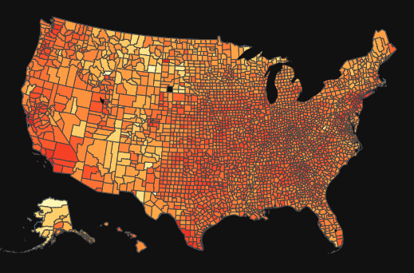
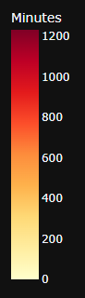
Distancing by County
April 2020
Oct 2020
Jan 2021

Slide 35
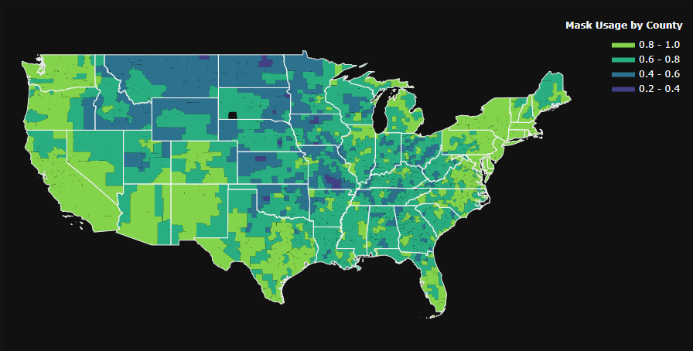
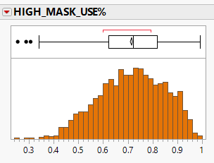
A July 2020 survey of how regularly people in each county wore masks from the New York Times

Slide 36
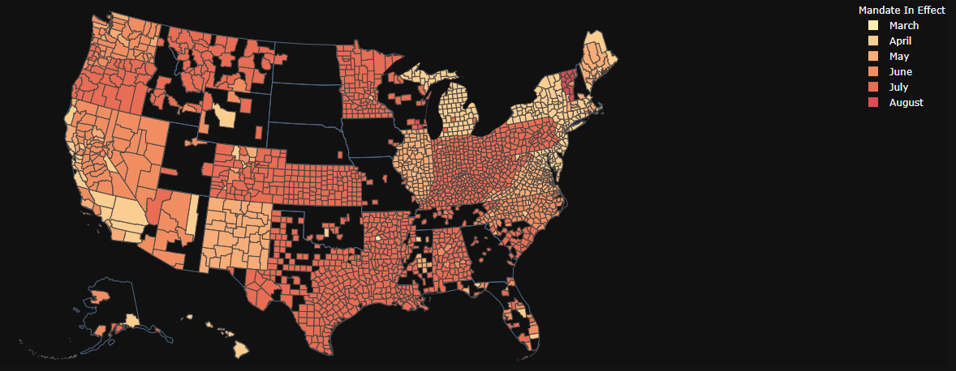
When mask mandates went into effect:

Slide 37
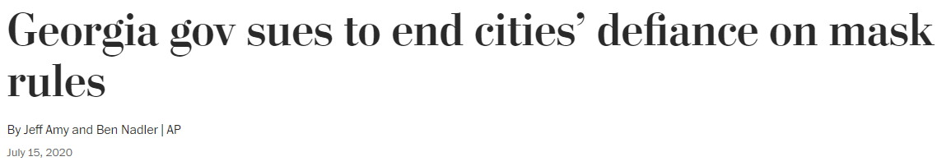
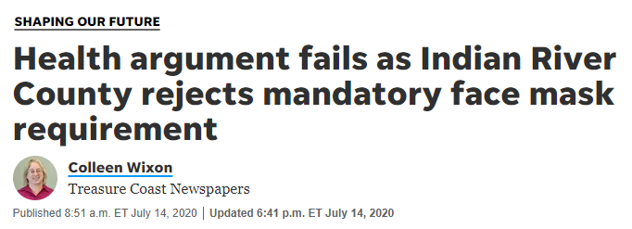

Mask Defiance
Headlines courtesy of:
Washington Post
TC Palm
Santa Fe New Mexican
201 Counties indicated that even if their state issued a mandate, they would not be enforcing masks:
Kansas - 85
Texas - 58
North Carolina - 14
Michigan - 10
Colorado – 6
Indiana - 6
New Mexico – 5
Illinois – 4
201 Total Counties
Oklahoma - 2
Ohio - 2
Florida - 2
Kentucky - 1
Louisiana - 3
Montana - 1
Pennsylvania – 1
Alabama - 1

Slide 38

Comparing Variables
Bivariate

Slide 39



Correlations with Partisanship
Mask Mandates
Distancing at Home
Online Sentiment

Slide 40
Are there significant differences between Republicans and Democrats?

Slide 41


t-Tests & Wilcoxon Rank Sums
COVID Outcomes
Masking Start Date
Distancing at Home
Online Sentiment
Partisanship
Partisanship x COVID Cases
Partisanship x COVID Deaths

Slide 42

t-Tests & Wilcoxon Rank Sums
COVID Outcomes
Masking Start Date
Distancing at Home
Online Sentiment
Partisanship
Party vs. months taken to institute a mask mandate

Slide 43

t-Tests & Wilcoxon Rank Sums
COVID Outcomes
Masking Start Date
Distancing at Home
Online Sentiment
Partisanship
Party vs. mean dwell time at home in minutes

Slide 44
t-Tests & Wilcoxon Rank Sums
COVID Outcomes
Masking Start Date
Distancing at Home
Online Sentiment
Partisanship
Sentiment by Party

Slide 45
t-Tests & Wilcoxon Rank Sums Conclusions
Masks
Distancing
Sentiment

Slide 46
Comparing Predictor Variables to Outcomes Variables

Slide 47

Masking & COVID Cases
COVID Outcomes
Masking Start Date
Distancing at Home
Online Sentiment
Partisanship
Cases are per 100k

Slide 48

Distancing & COVID Cases
COVID Outcomes
Masking Start Date
Distancing at Home
Online Sentiment
Partisanship
Cases are per 100k
Took a random sample of 500 rows

Slide 49

Masking & COVID Deaths
COVID Outcomes
Masking Start Date
Distancing at Home
Online Sentiment
Partisanship

Slide 50

Distancing & COVID Deaths
COVID Outcomes
Masking Start Date
Distancing at Home
Online Sentiment
Partisanship

Slide 51
Sentiment & COVID Cases
COVID Outcomes
Masking Start Date
Distancing at Home
Online Sentiment
Partisanship
Cases are per 100k

Slide 52
Sentiment & COVID Deaths
COVID Outcomes
Masking Start Date
Distancing at Home
Online Sentiment
Partisanship

Slide 53
EDA Conclusions:
Mask and Distance Data
Metrics
Next Steps:
There is an upward trend for both cases and deaths as the number of months to initiate a mask mandate increases. Slope more pronounced for cases than deaths.
There is a downward trend for both cases and deaths as the number of minutes spent at home increases.
R-Squares are not indicative of much correlation of X to Y despite getting significant p-values.

Slide 54
Research Design

Slide 55

The Math

Slide 56
Results

Slide 57
Discussion

Slide 58
Final Thoughts

Slide 59
Acknowledgements

